Slide 1
African Countries
Part of research done for Video Games as an Educational Medium

Slide 2
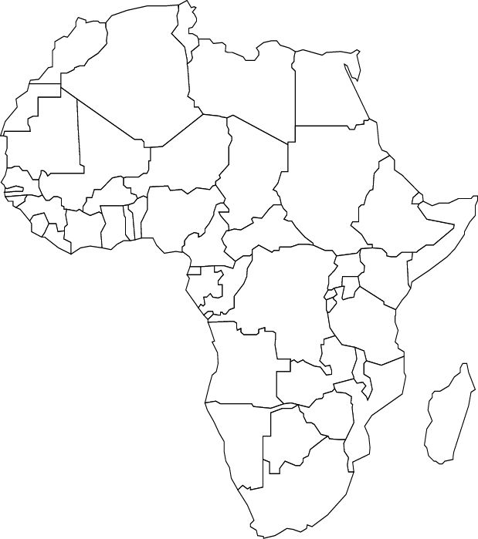
There are 54 countries in Africa.
We will be showing you what each of them look like in alphabetical order.
Then we will show some examples of mnemonics that could be helpful for learning the names of the countries.

Slide 3
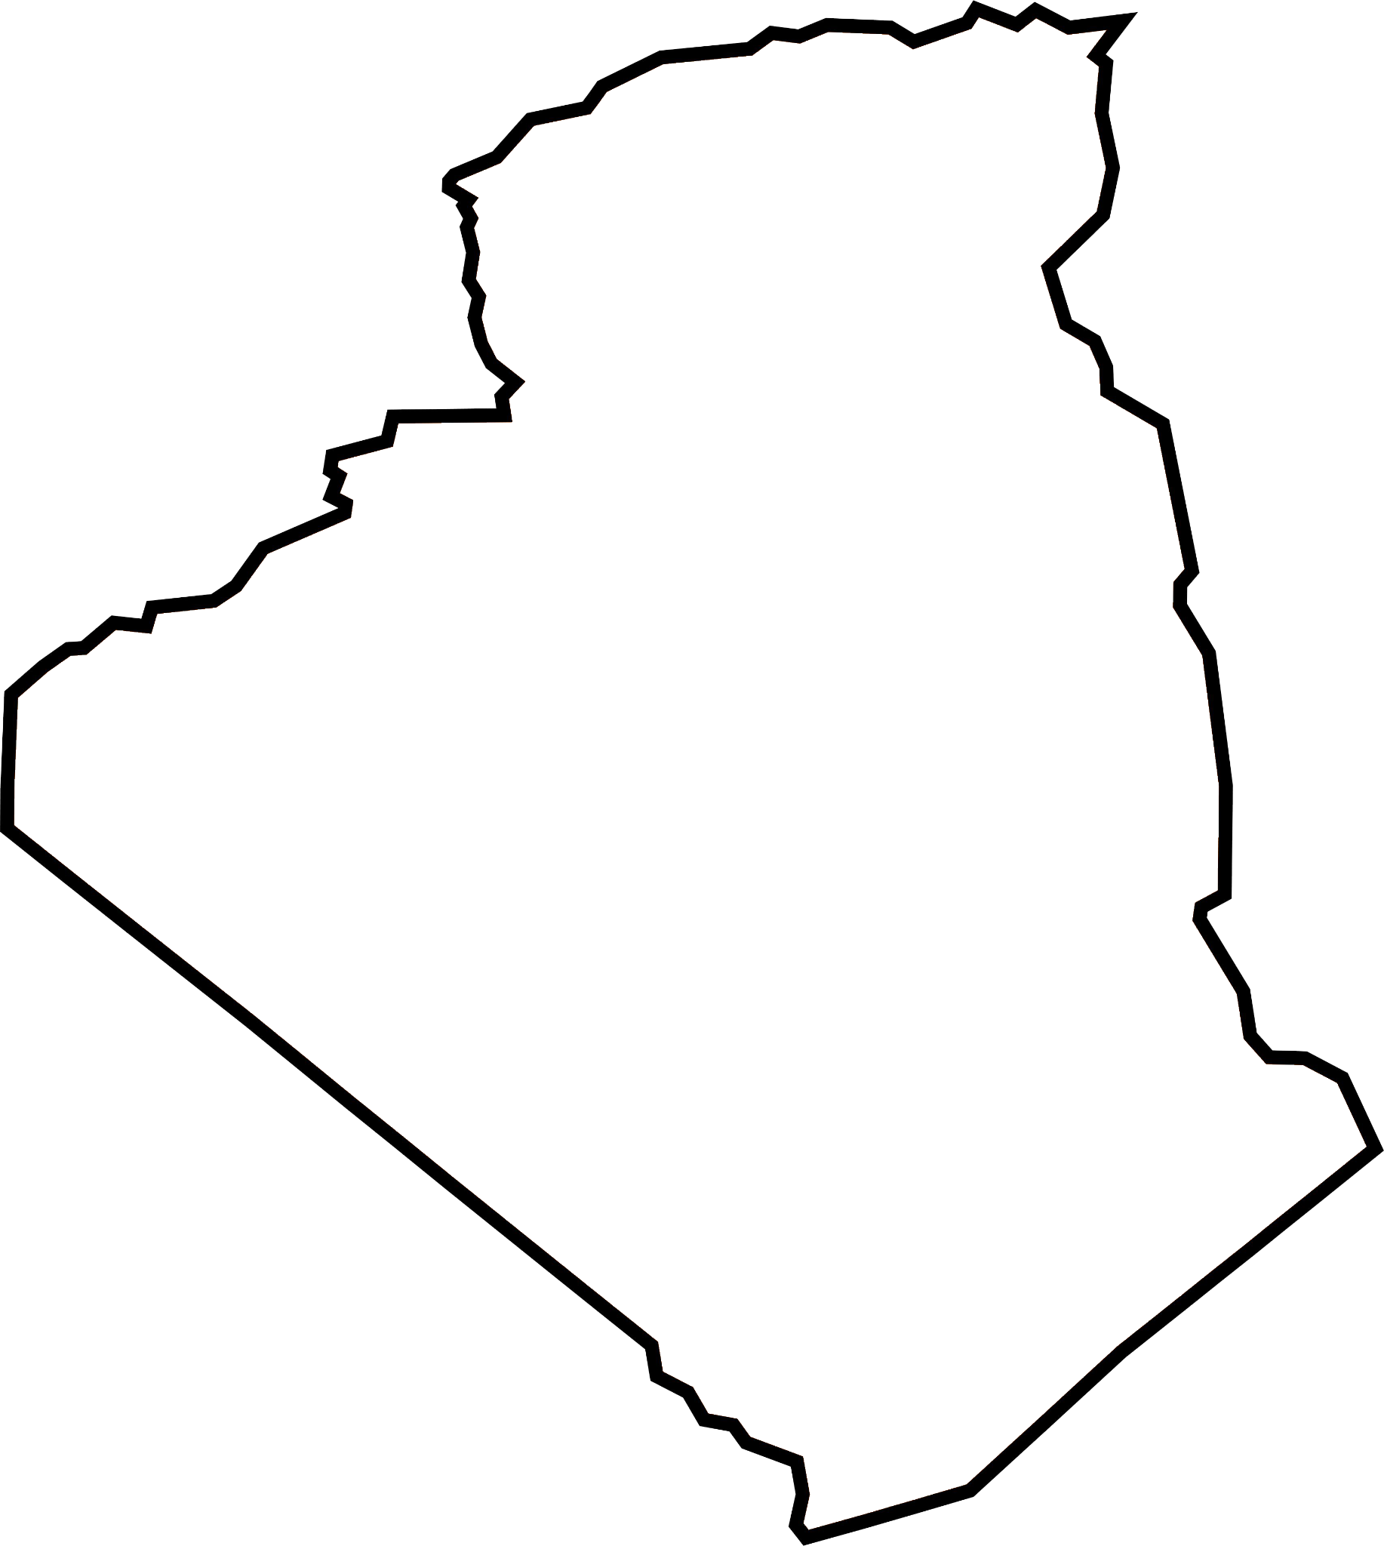
Algeria

Slide 4
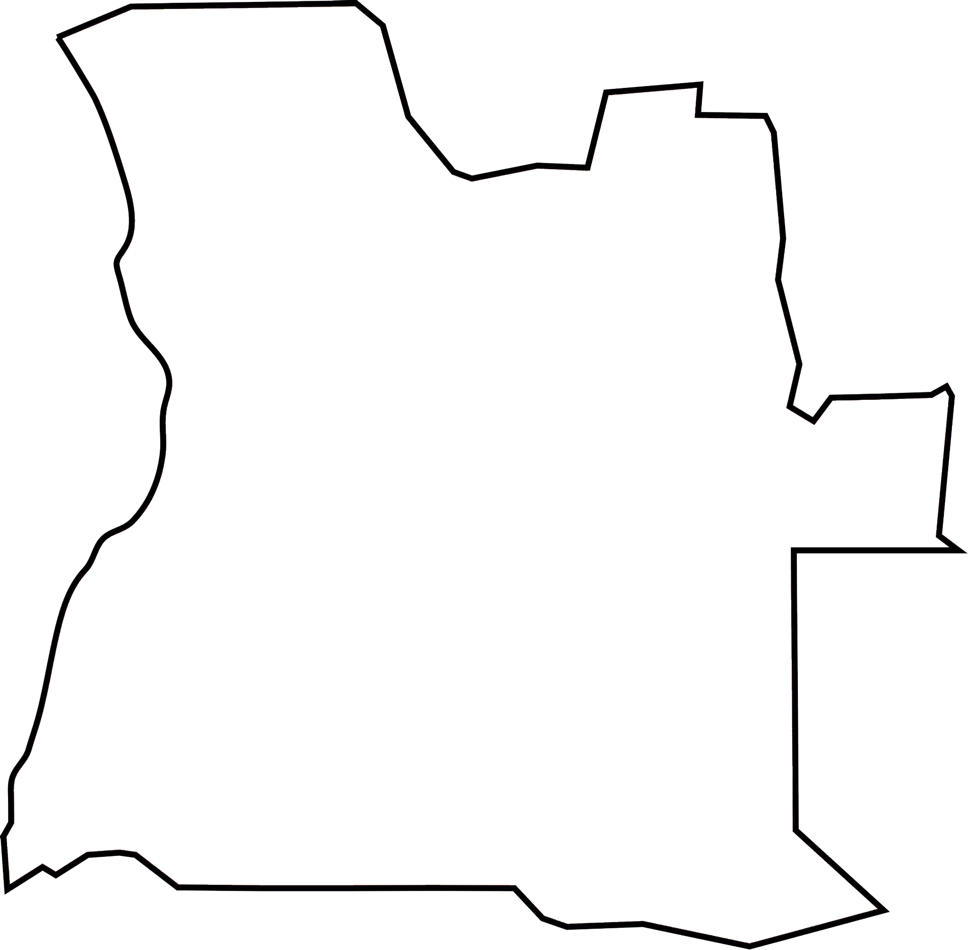
Angola

Slide 5

Benin

Slide 6
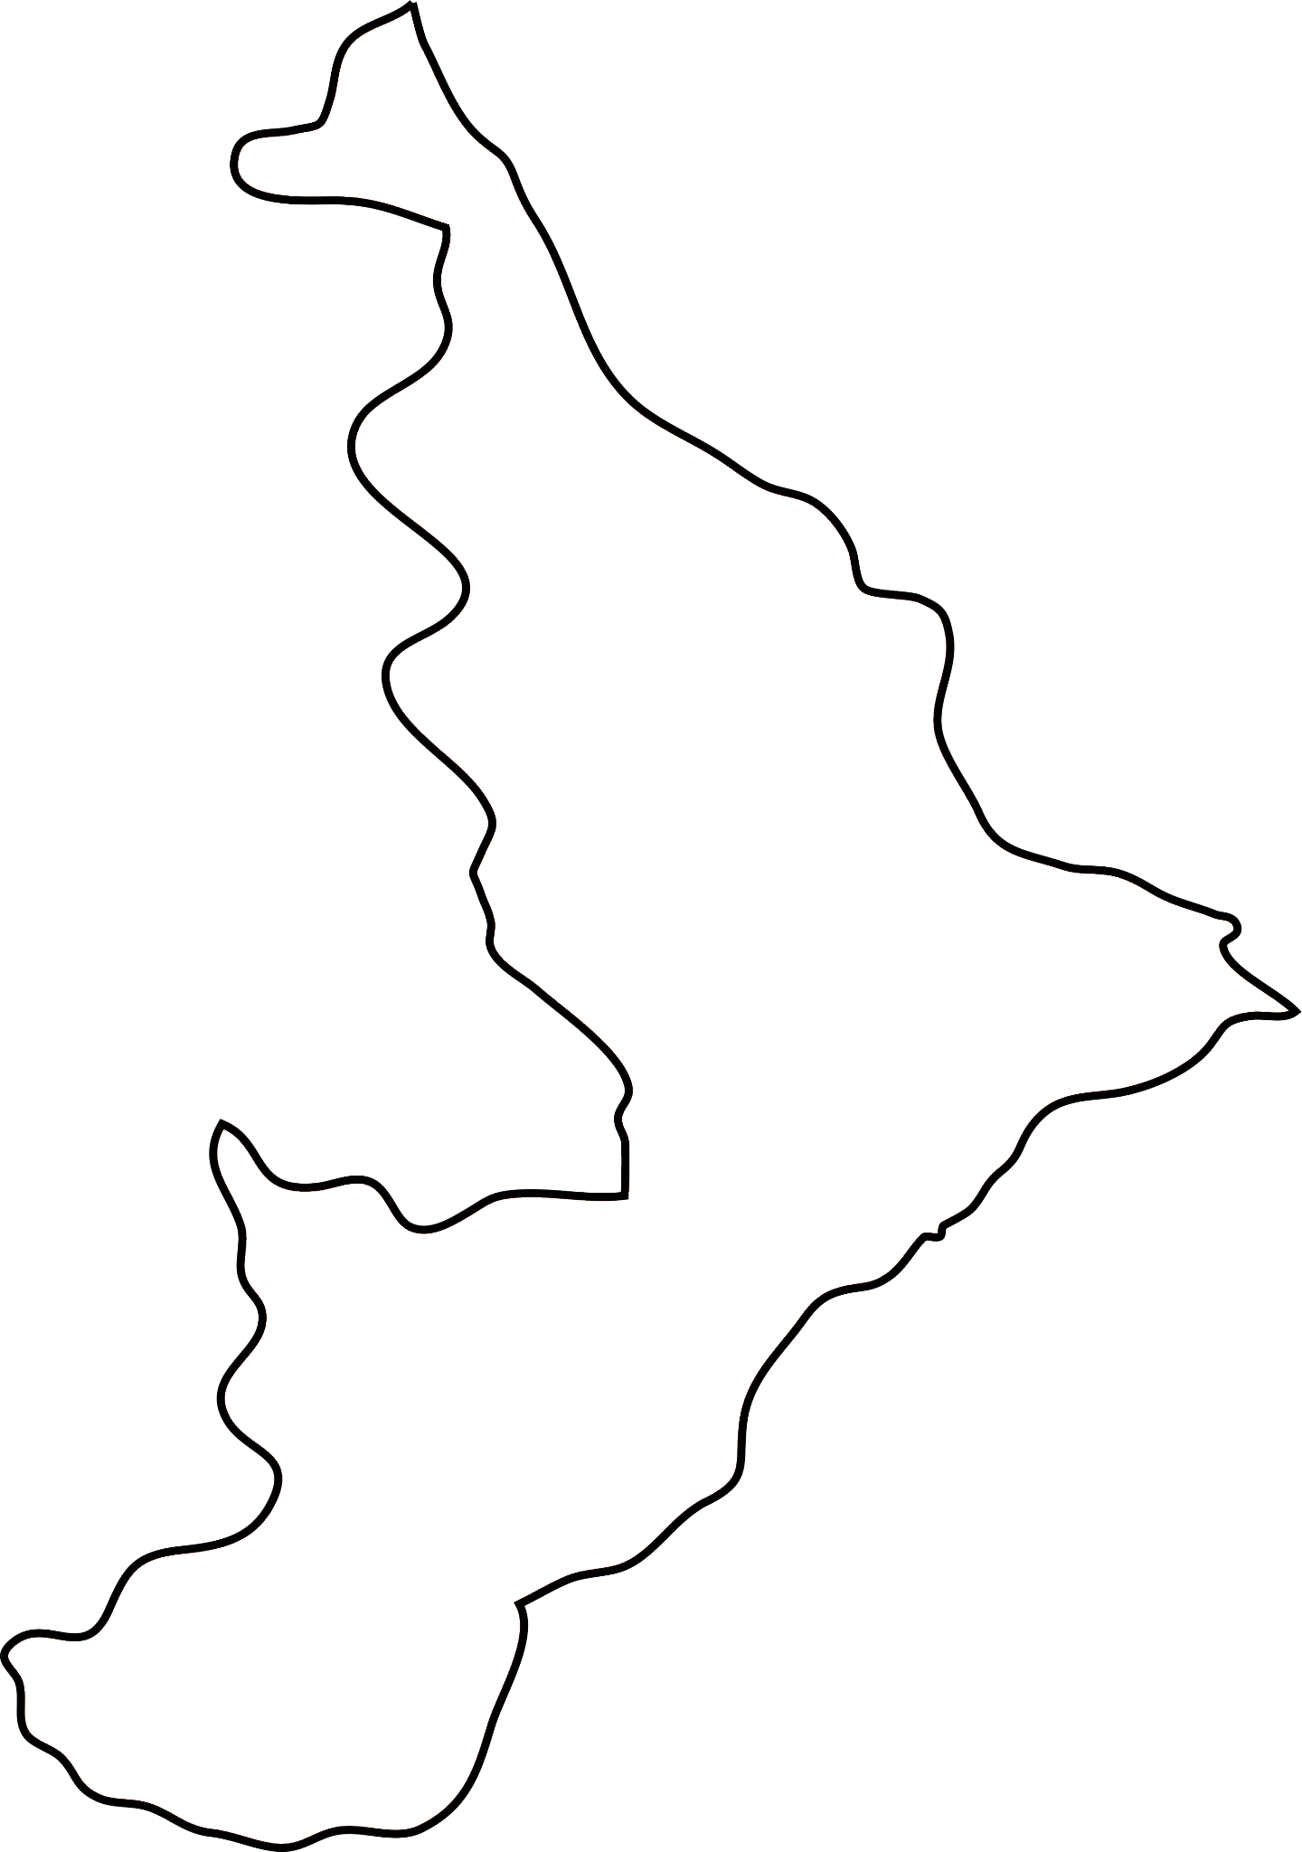
Botswana

Slide 7
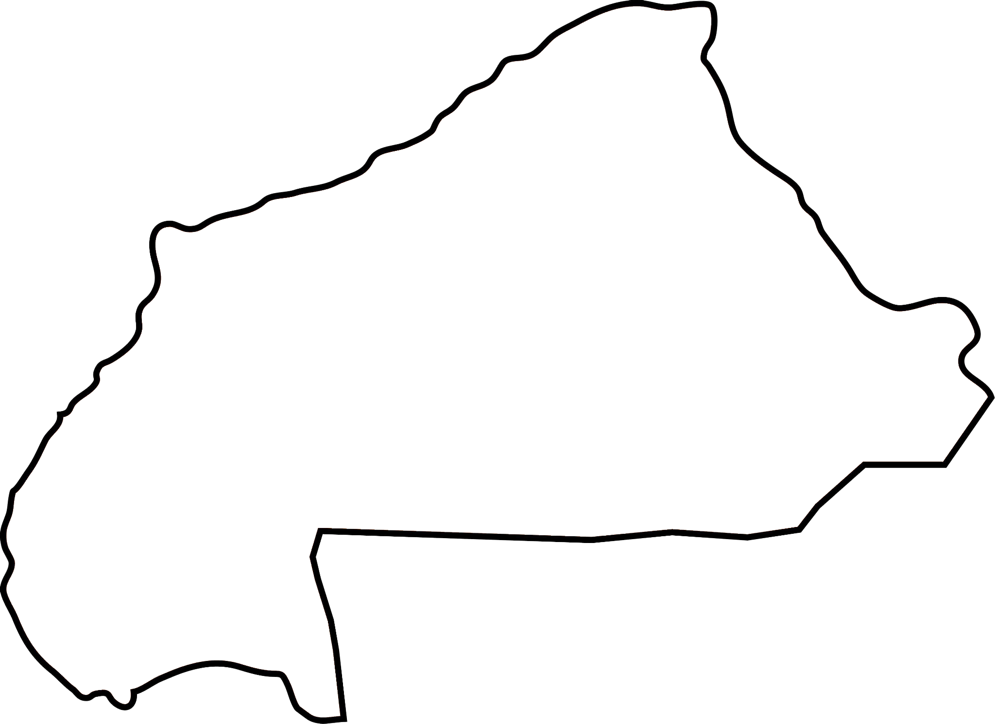
Burkina Faso

Slide 8
Burundi

Slide 9
Cameroon

Slide 10
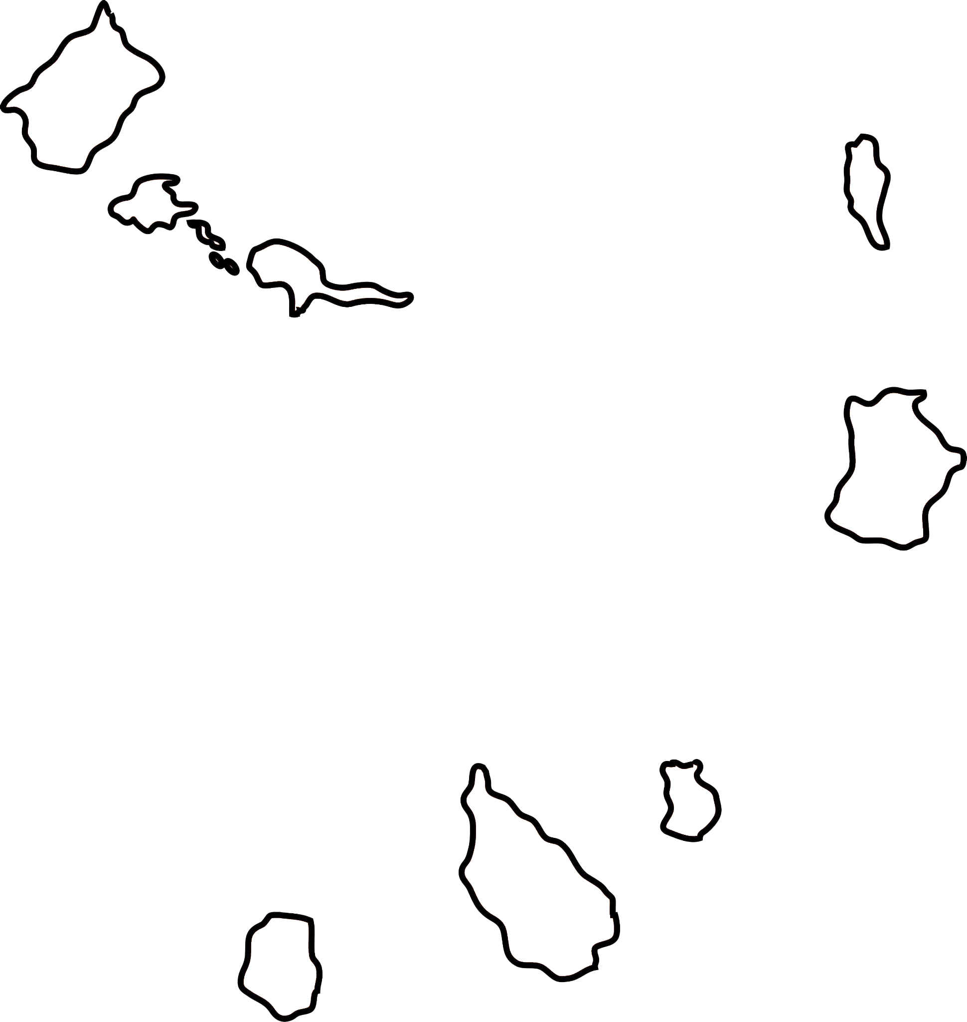
Cape Verde

Slide 11
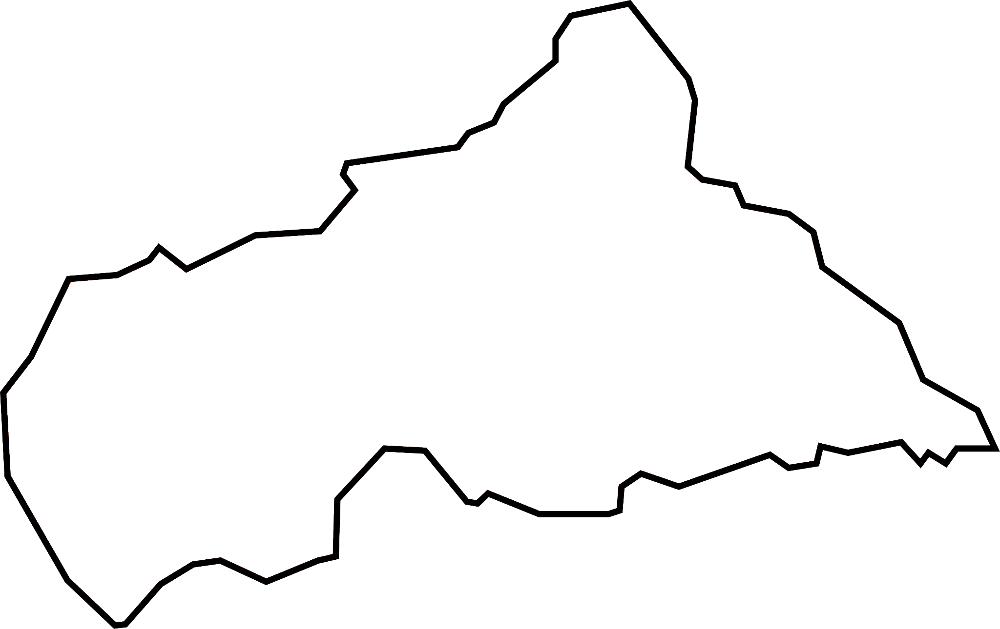
Central African Republic

Slide 12
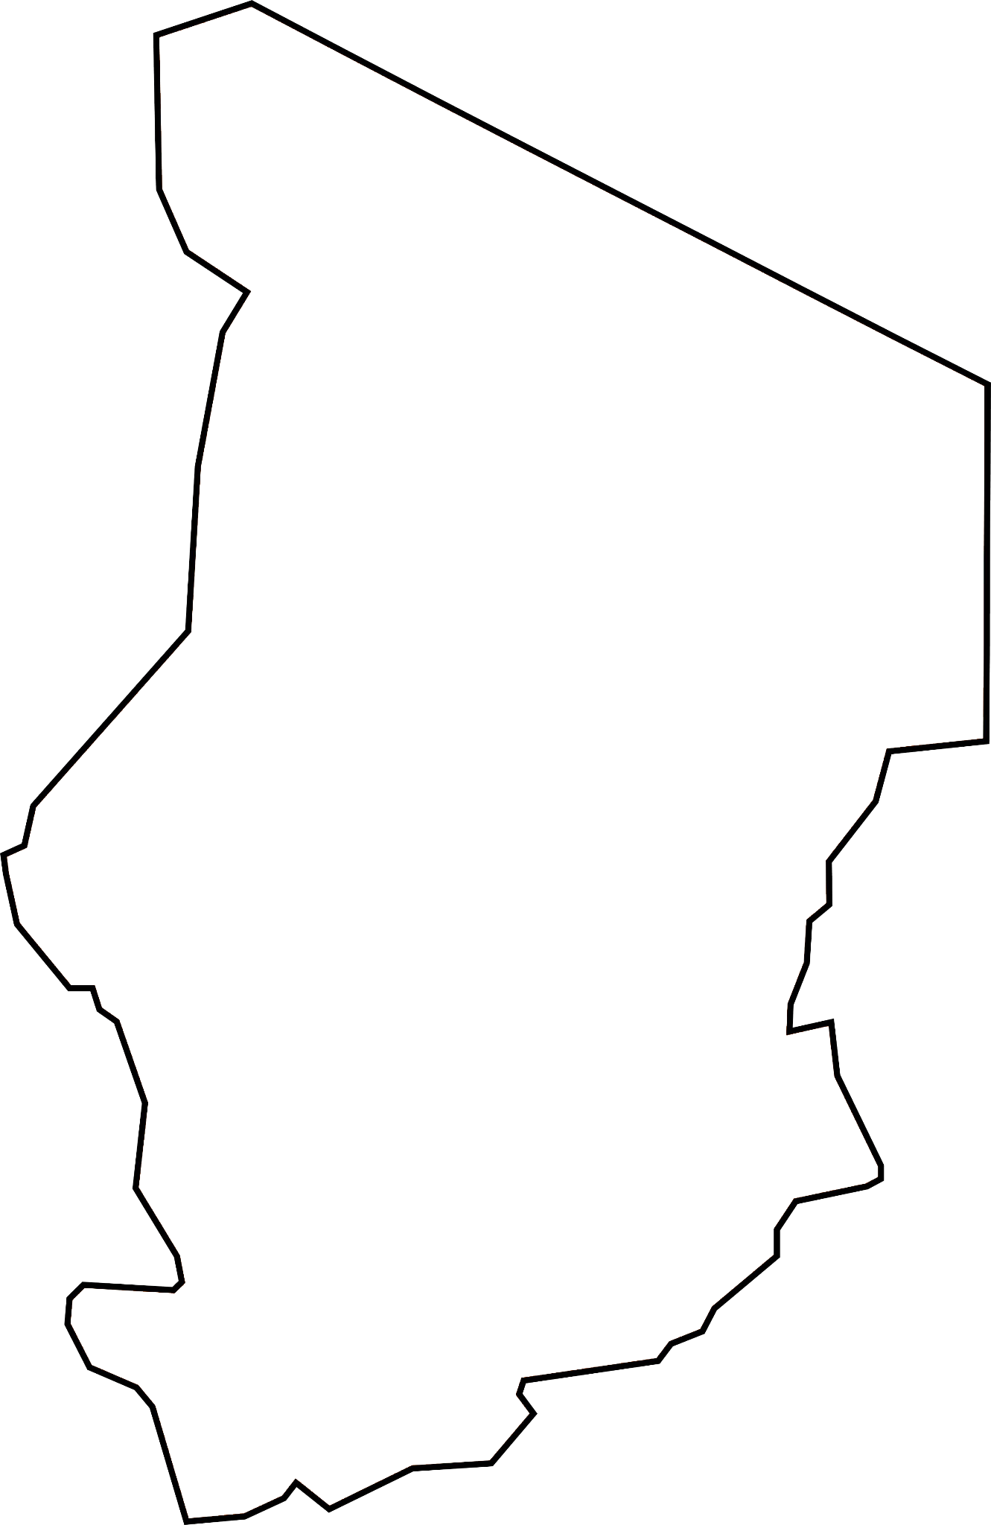
Chad

Slide 13
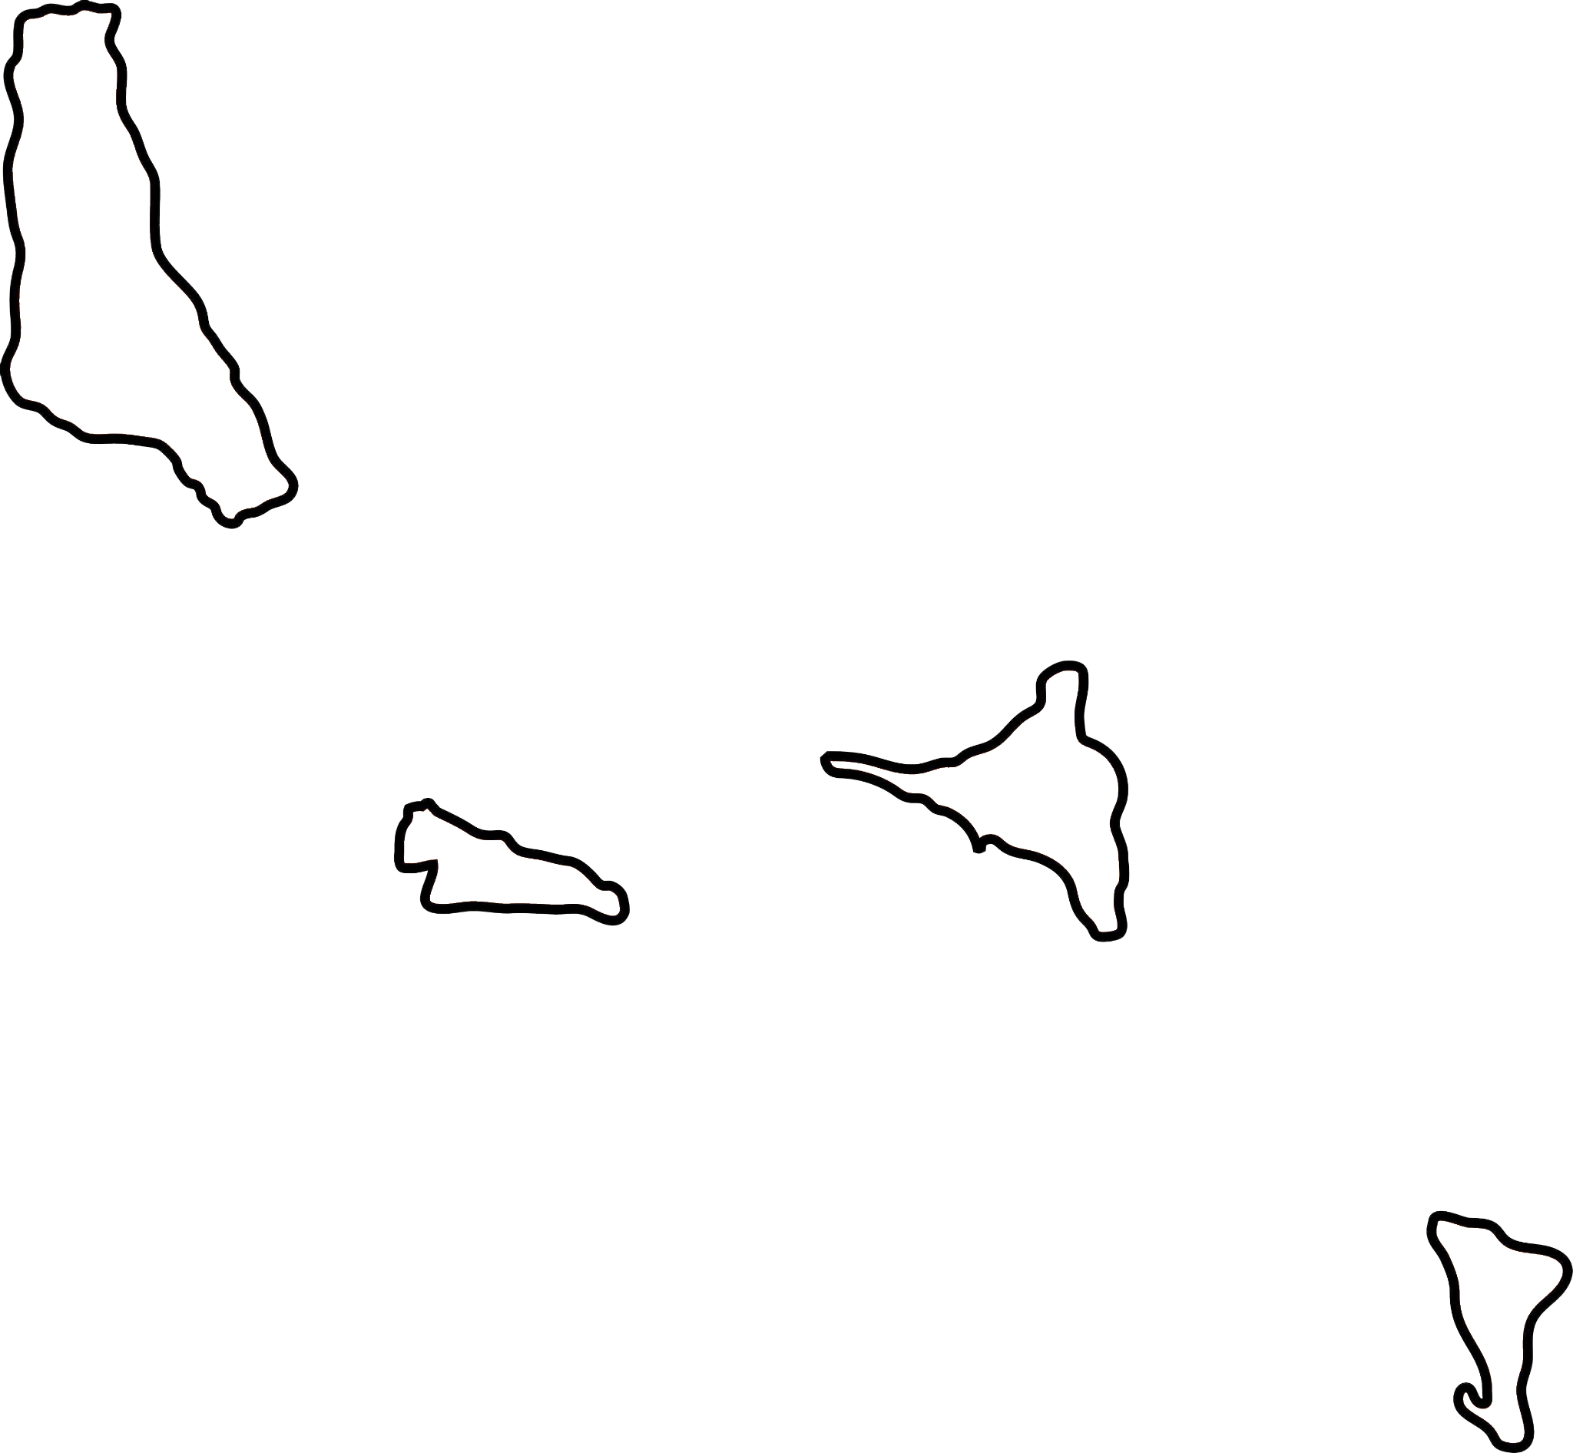
Comoros

Slide 14
Congo

Slide 15
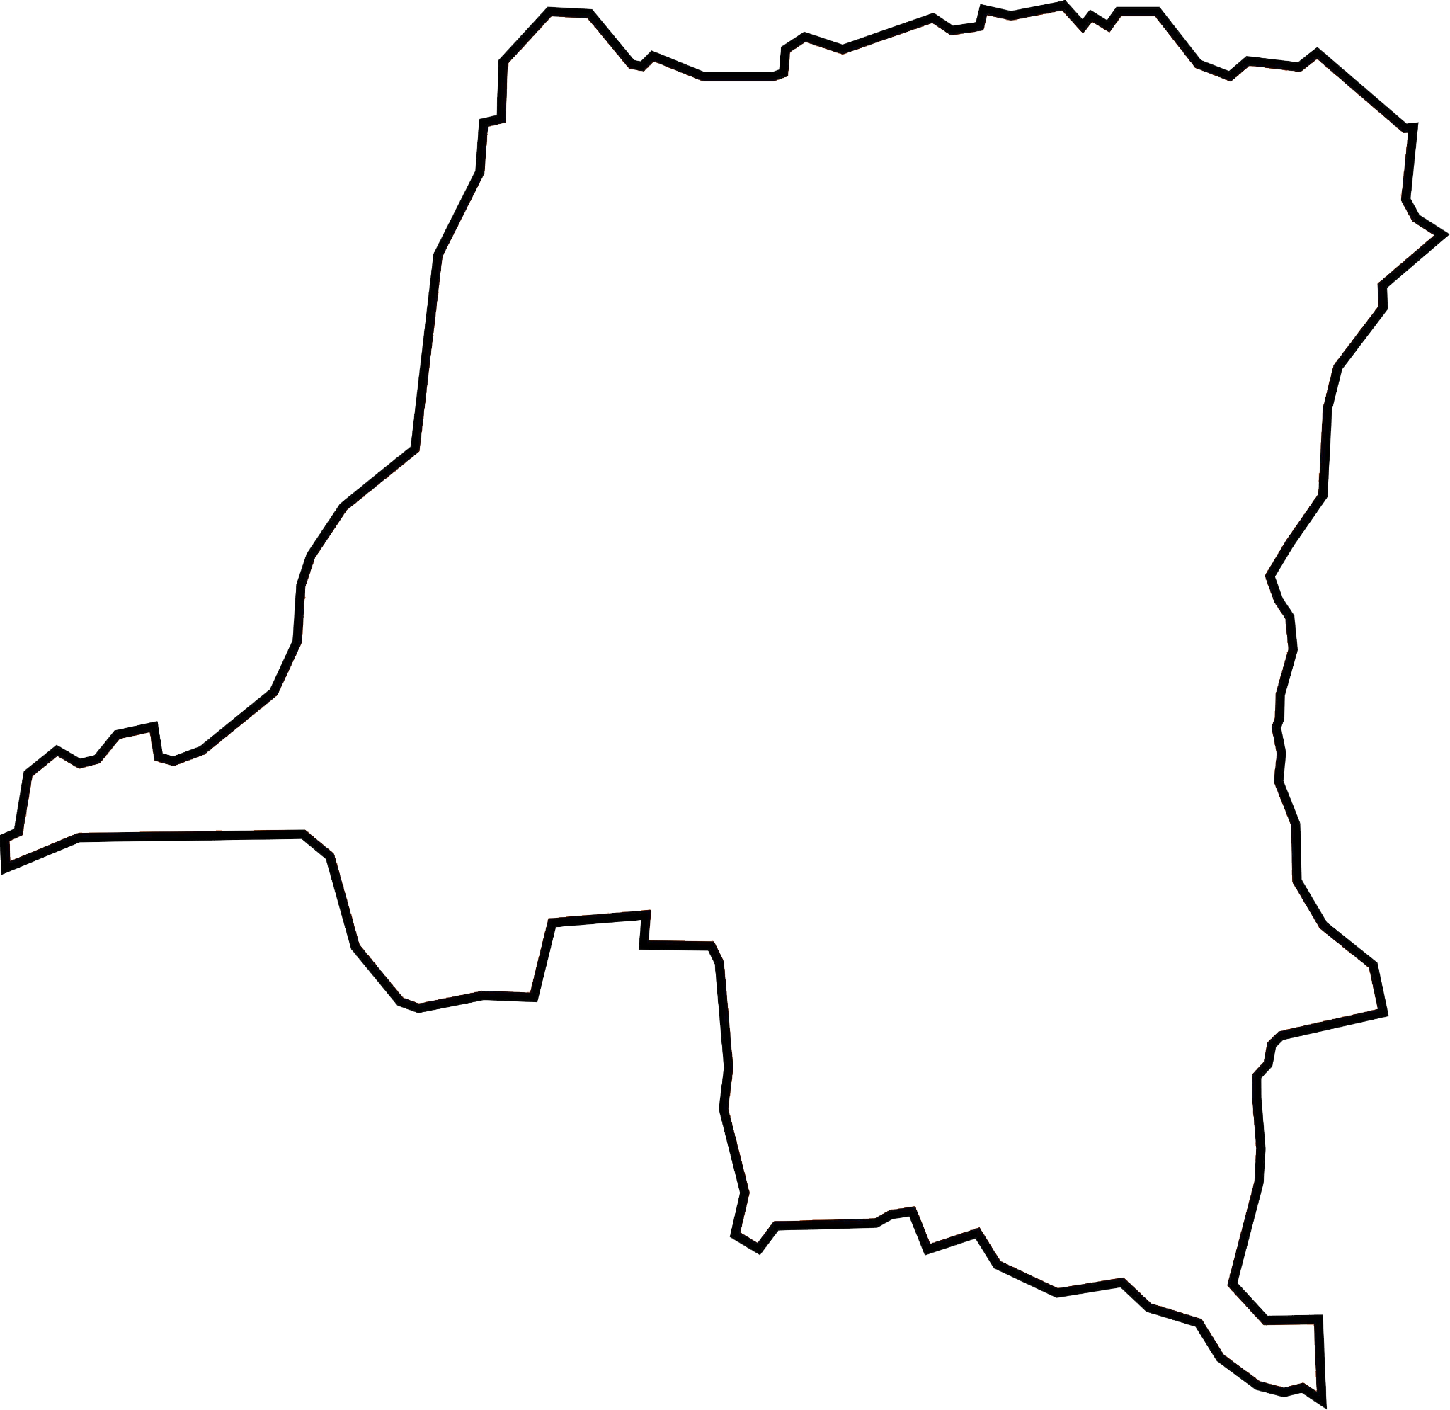
Democratic
Republic of
Congo

Slide 16
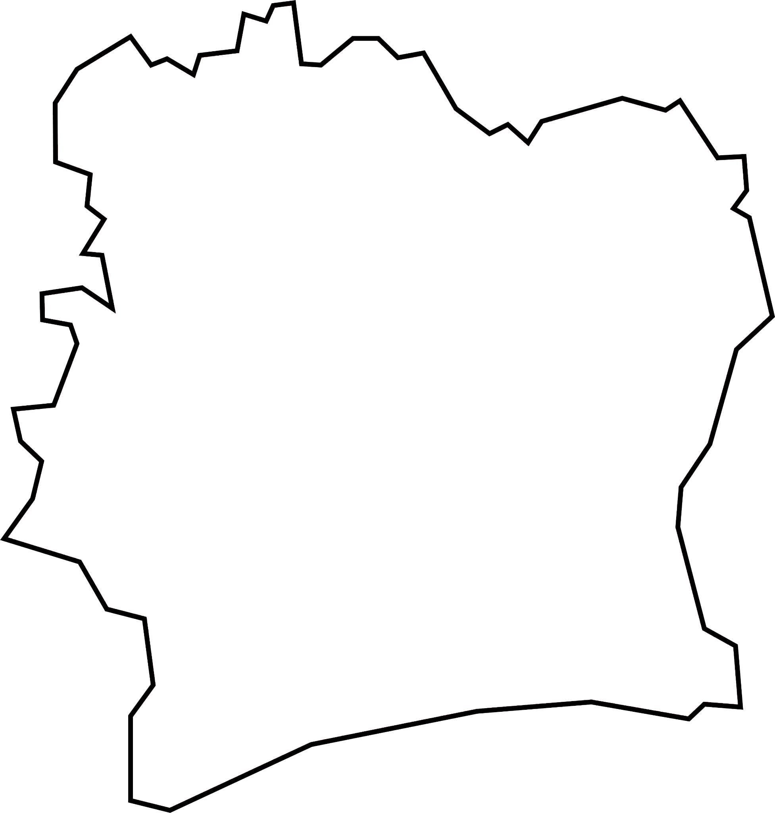
Ivory Coast

Slide 17
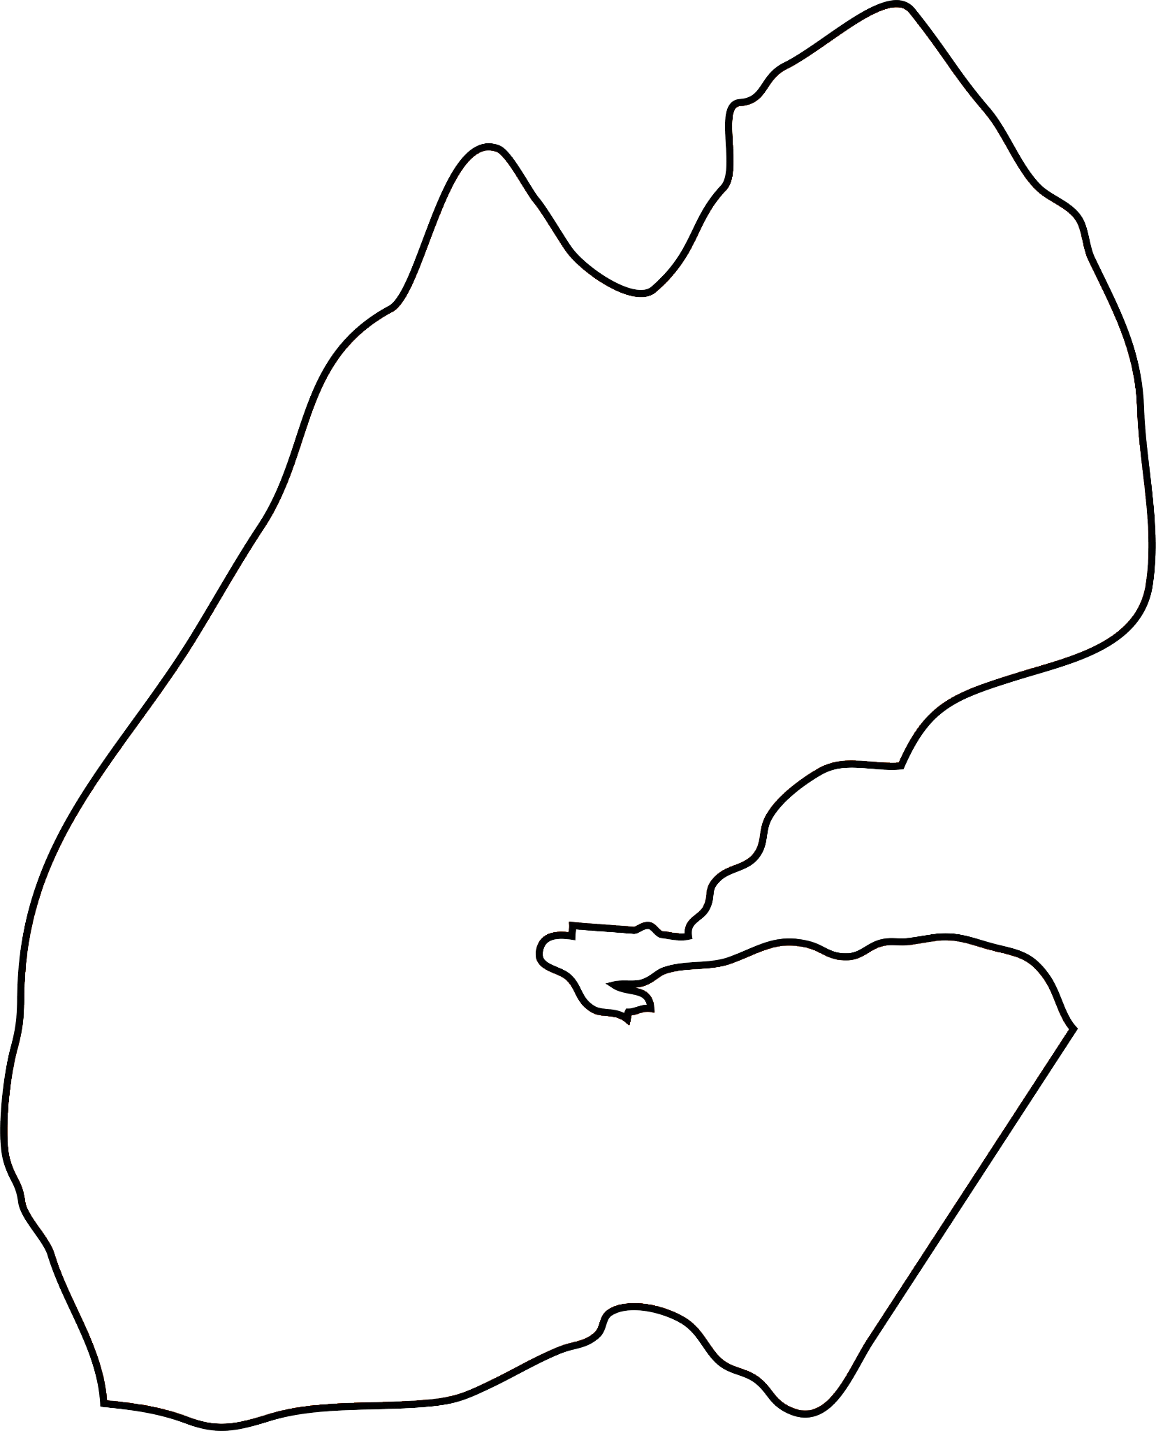
Djibouti

Slide 18
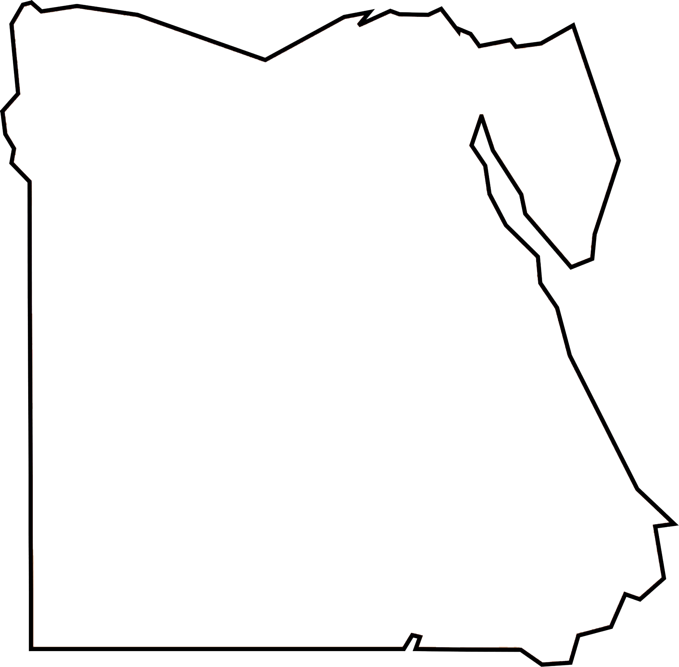
Egypt

Slide 19
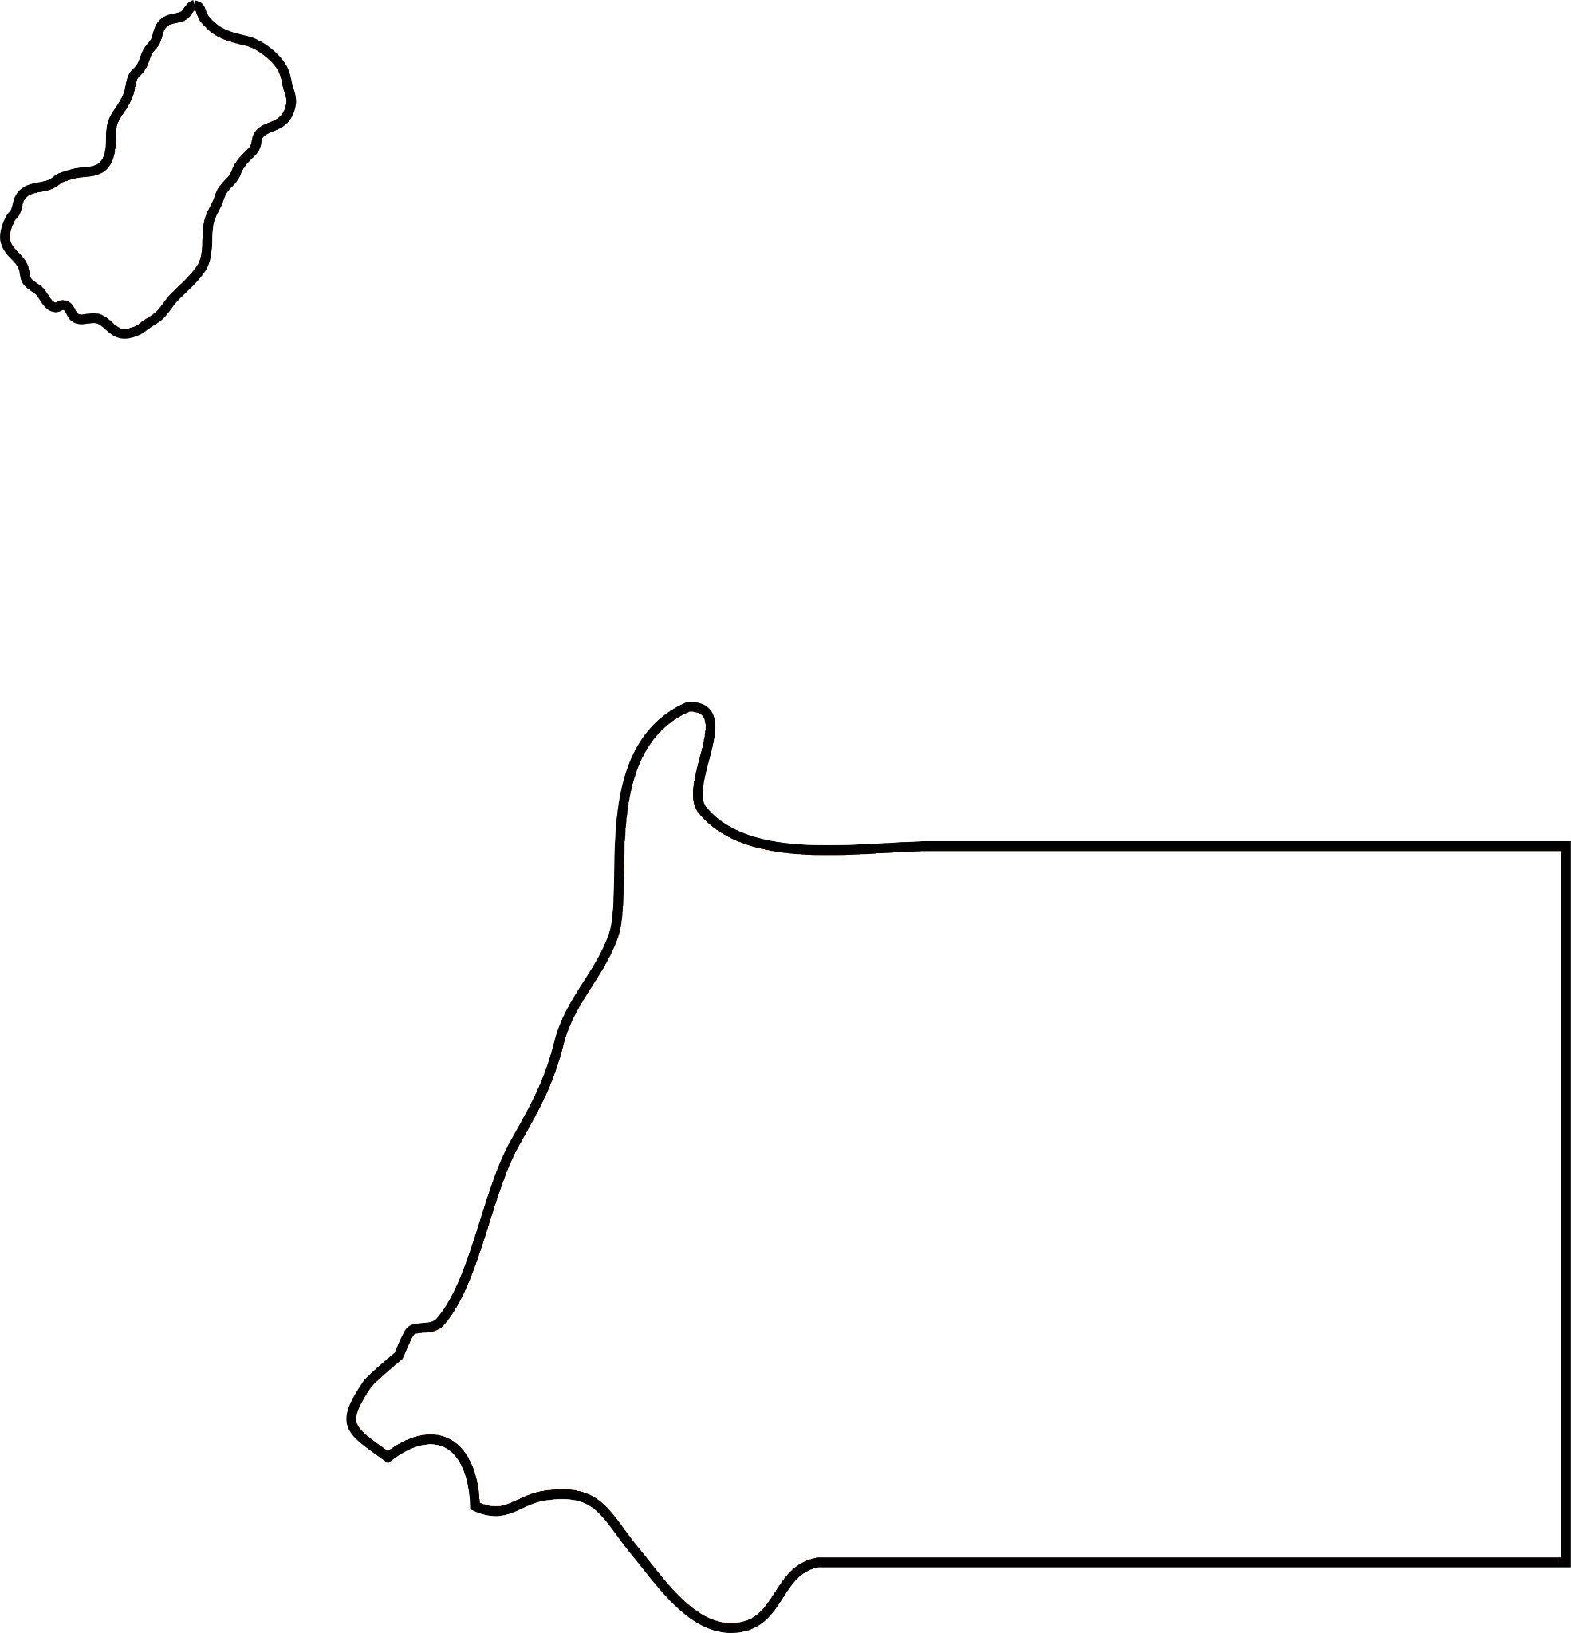
Equatorial
Guinea

Slide 20

Eritrea

Slide 21
Ethiopia

Slide 22
Gabon

Slide 23
Gambia

Slide 24
Ghana

Slide 25
Guinea

Slide 26
Guinea-bissau

Slide 27
Kenya

Slide 28
Lesotho

Slide 29
Liberia

Slide 30
Libya

Slide 31
Madagascar

Slide 32
Malawi

Slide 33
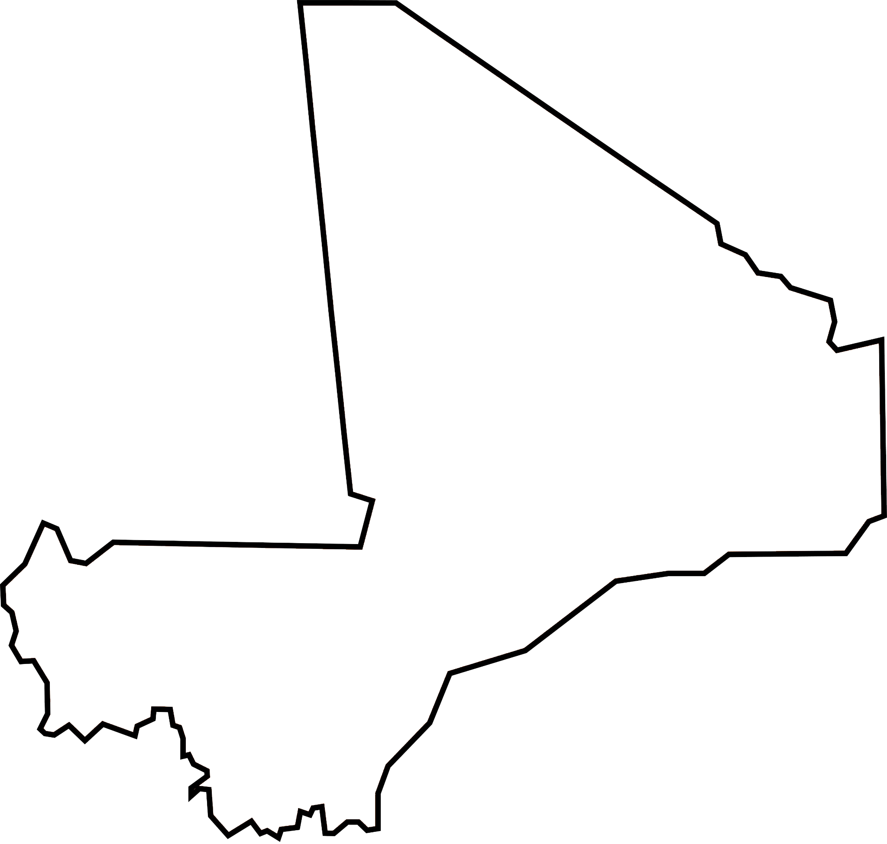
Mali

Slide 34
Mauritania

Slide 35
Mauritius

Slide 36
Morocco

Slide 37
Mozambique

Slide 38
Nambia

Slide 39
Niger

Slide 40
Nigeria

Slide 41
Rwanda

Slide 42

Sao Tome
And Principe

Slide 43
Senegal

Slide 44
Seychelles

Slide 45
Sierra Leone

Slide 46
Somalia

Slide 47
South Africa

Slide 48
South Sudan

Slide 49
Sudan

Slide 50
Swaziland

Slide 51
Tanzania

Slide 52
Togo

Slide 53
Tunisia

Slide 54
Uganda

Slide 55
Zambia

Slide 56
Zimbabwe

Slide 57
Now that we’ve gone through all of the countries, here are some examples of mnemonic devices that can be used to better remember the names of the countries.

Slide 58
Algae And Ben Bought Birkenstocks Fast, But Cameron’s Green Cape* Centralized Africa’s Republic
Algeria, Angola, Benin, Botswana, Burkina Faso, Burundi, Cameroon, Cape Verde, Central African Republic
ADD PICTURES OF COUNTRIES WHEN ALL OUTLINES ARE DONE

Slide 59
Chad’s coma conned (the) Ivory Coast Diligently
Chad, Comoros, Congo, Ivory Coast, Djibouti
ADD PICTURES OF COUNTRIES WHEN ALL OUTLINES ARE DONE

Slide 60
Eggs Everywhere Go Eccentric
Egypt, Equatorial Guinea, Eritrea
ADD PICTURES OF COUNTRIES WHEN ALL OUTLINES ARE DONE

Slide 61
Ethel Got Good Grades
Ethiopia, Gabon, Gambia, Ghana
ADD PICTURES OF COUNTRIES WHEN ALL OUTLINES ARE DONE

Slide 62
Good Grief Boys
Guinea, Guinea-Bissau
ADD PICTURES OF COUNTRIES WHEN ALL OUTLINES ARE DONE

Slide 63
Kent (and) Lois Lane Live (in) Manhattan
Kenya, Lesotho, Liberia, Libya, Madagascar
ADD PICTURES OF COUNTRIES WHEN ALL OUTLINES ARE DONE

Slide 64
Ma Ma Married Maurice
Malawi, Mali, Mauritania, Mauritius
ADD PICTURES OF COUNTRIES WHEN ALL OUTLINES ARE DONE

Slide 65
Moroccos Make Noise
Morocco, Mozambique, Namibia
ADD PICTURES OF COUNTRIES WHEN ALL OUTLINES ARE DONE

Slide 66
Never Never Run (with) Scissors To (the) Potty
Niger, Nigeria, Rwanda, Sao Tome and Principe
ADD PICTURES OF COUNTRIES WHEN ALL OUTLINES ARE DONE

Slide 67
Several Snakes Slither Somewhere (to) South Africa
Senegal, Seychelles, Sierra Leone, Somalia, South Africa
ADD PICTURES OF COUNTRIES WHEN ALL OUTLINES ARE DONE

Slide 68
Suddenly Swayze Takes To-go To (the) Zoo Zoo
Sudan, Swaziland, Tanzania, Togo, Tunisia, Uganda, Zambia, Zimbabwe
ADD PICTURES OF COUNTRIES WHEN ALL OUTLINES ARE DONE

